Slide 1
Smart Dustbin

Slide 2
Presented by:
Name: Md. Nahidul Haque Nirab
Id: 2018100000023
Batch: 49
Name: Shafikul Islam
Id: 2017000000174
Batch: 45
Name: Johurul Islam
Id: 2019000000113
Batch: 51
Submitted To:
Ovishek Sen
Lecturer
Department of CSE
Southeast University, Dhaka.

Slide 3

Smart Dustbin

Slide 4
Equipments
ARDUINO Uno
SG90 Micro-servo motor
Ultrasonic Sensor HC-SR04
Connecting wire
Bucket/Bin
ARDUINO IDE (Application)
Power Supply

Slide 5
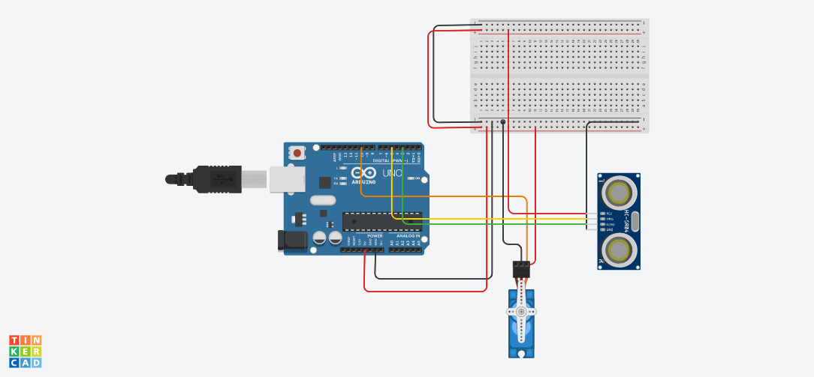
Circuit Diagram

Slide 6
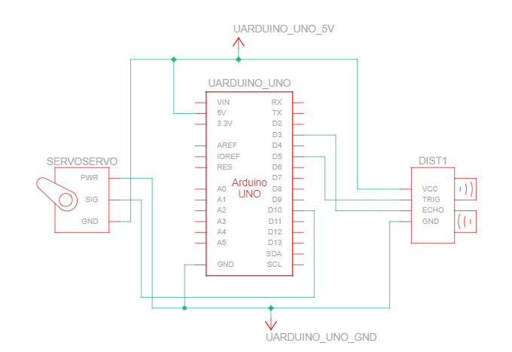
Block Diagram

Slide 7
Servo Motor
Used in Industry
Used in radio-controlled airplanes
Used in robots
Used by the aerospace industry
Used in many radio controlled toys.
Used in electronic devices
Used in automobiles.

Slide 8
Ultrasonic Distance Sensor
Smart Dustbin
Glass for blind people
Toy
Drone
Parking radar
Automatic hand wash sanitizer

Slide 9
ARDUINO UNO
used in all projects
To upload the program

Slide 10
Program
#include <Servo.h> //servo library
Servo servo;
int trigPin = 5;
int echoPin = 3;
int servoPin = 10;
long duration, dist, average;
long aver[3]; //array for average
void setup() {
Serial.begin(9600);
servo.attach(servoPin);
pinMode(trigPin, OUTPUT);
pinMode(echoPin, INPUT);
servo.write(0); //close cap on power on
delay(100);
servo.detach();
}

Slide 11
Program
void measure() {
digitalWrite(10,HIGH);
digitalWrite(trigPin, LOW);
delayMicroseconds(5);
digitalWrite(trigPin, HIGH);
delayMicroseconds(15);
digitalWrite(trigPin, LOW);
pinMode(echoPin, INPUT);
duration = pulseIn(echoPin, HIGH);
dist = (duration/2) / 29.1; //obtain distance
}
void loop() {
for (int i=0;i<=2;i++) { //average distance
measure();
aver[i]=dist;
delay(10); //delay between measurements
}
dist=(aver[0]+aver[1]+aver[2])/3;

Slide 12
Program
if ( dist<50 ) {
//Change distance as per your need
servo.attach(servoPin);
delay(1);
servo.write(0);
delay(3000);
servo.write(150);
delay(1000);
servo.detach();
}
Serial.print(dist);
}

Slide 13
Reference
https://www.youtube.com/watch?v=9yrP1CZN3Ds
Tinkercad: https://www.tinkercad.com/things/ijFN4qfyQ2I-wiring-components/editel?lessonid=EB4XNWQJ1WEOONK&projectid=OLORCO6L20FZRZ7&collectionid=undefined#/lesson-viewer

Slide 14
Thank you
Any Question?

